Slide 1

Web Development with Python/Django
Dr. Abdelhameed Ibrahim
Assoc. Prof. of Computer Engineering

Slide 2
Learning Objectives
You will learn
Different views format, Include() function
Static directory
More classes for database
2

Slide 3
Learning Objectives
You will learn
Different views format, Include() function
Static directory
More classes for database
3

Slide 4
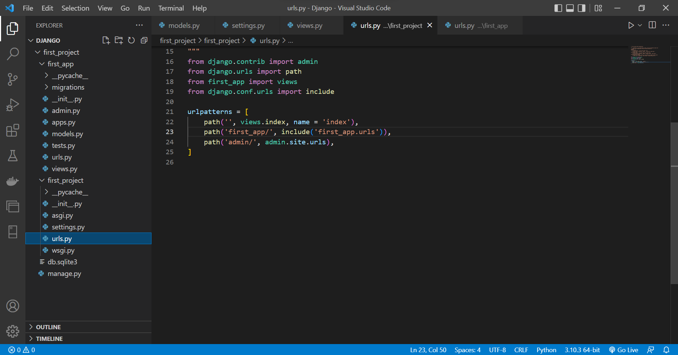
4

Slide 5
Project: Urls.py
from django.contrib import admin
from django.urls import path
from first_app import views
from django.conf.urls import include
urlpatterns = [
path('', views.index, name = 'index'),
path('first_app/', include('first_app.urls')),
path('admin/', admin.site.urls),
]
5

Slide 6
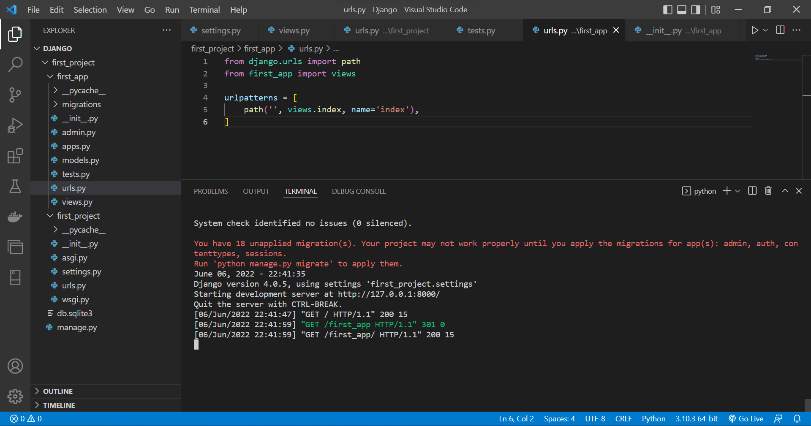
6

Slide 7
App: Urls.py
from django.urls import path
from first_app import views
urlpatterns = [
path('', views.index, name='index'),
]
7

Slide 8
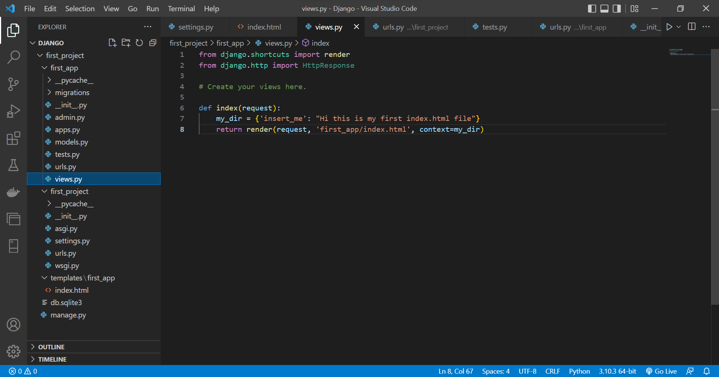
8

Slide 9
Learning Objectives
You will learn
Different views format, Include() function
Static directory, for css, js, images
More classes for database
9

Slide 10
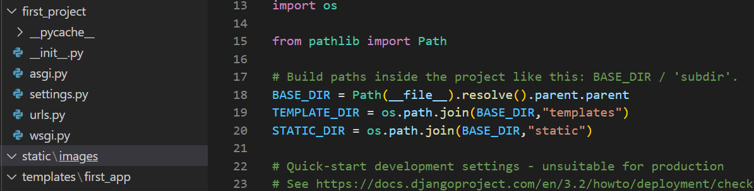
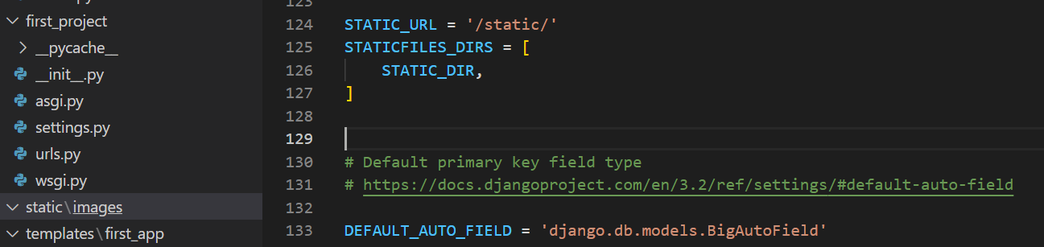
Static directory
10

Slide 11
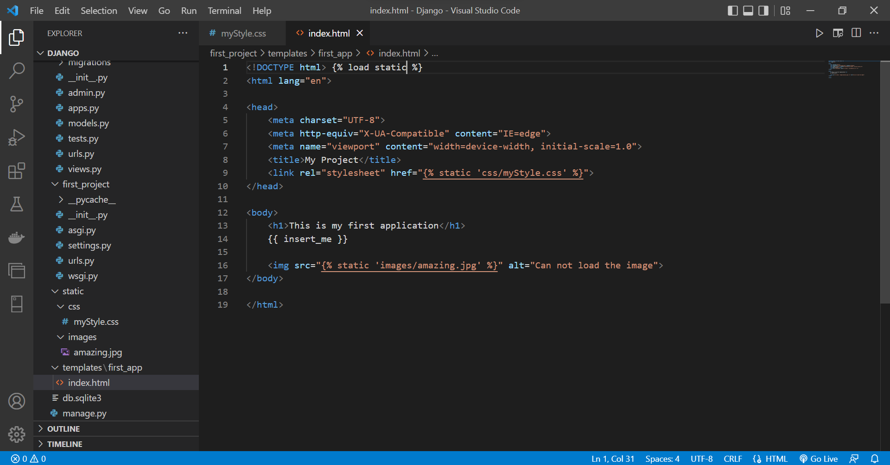
11

Slide 12
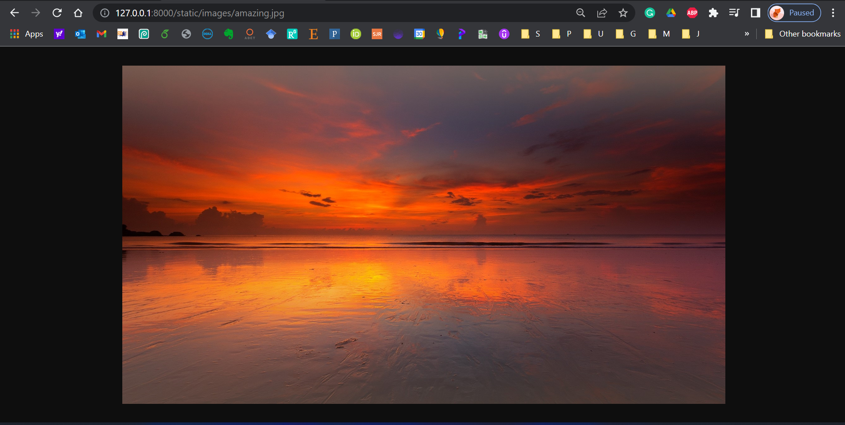
12

Slide 13
Learning Objectives
You will learn
Different views format, Include() function
Static directory, for css, js, images
More classes for database
13

Slide 14
More classes for database
To display an object in the Django admin site and as the value inserted into a template when it displays an object.
https://docs.djangoproject.com/en/4.1/ref/models/instances/
class Topic(models.Model):
top_name = models.CharField(max_length=264, unique=True)
def __str__(self):
return self. top_name
class Webpage(models.Model):
category = models.ForeignKey(Topic)
name = models.CharField(max_length=264)
url = models.URLField()
def __str__(self):
return self.name
14

Slide 15
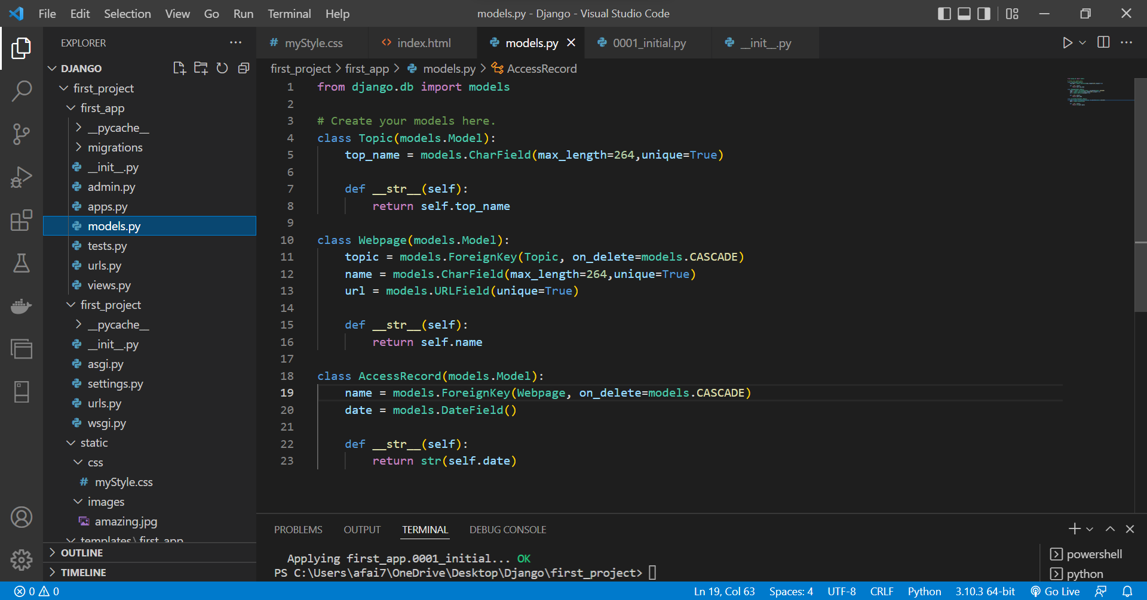
15

Slide 16
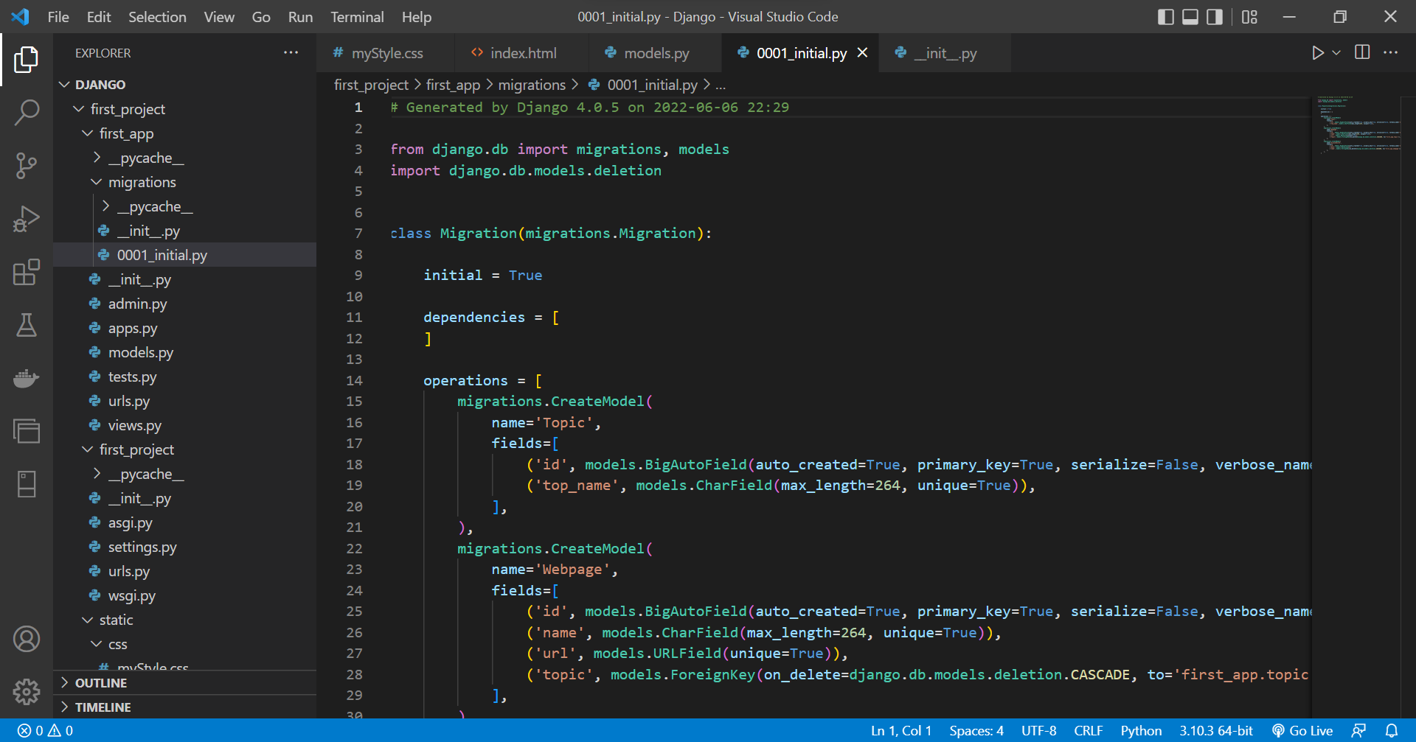
16

Slide 17
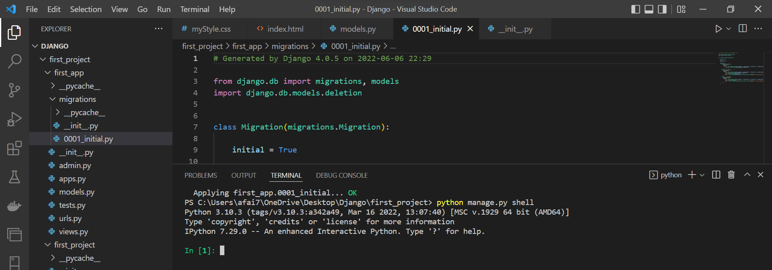
Run test data
17

Slide 18
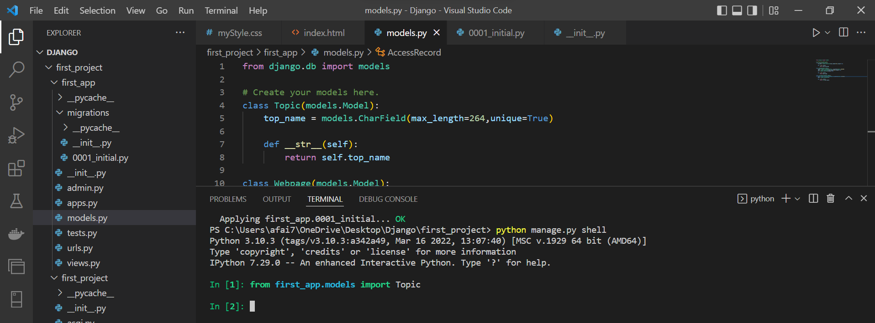
Insert data
18

Slide 19
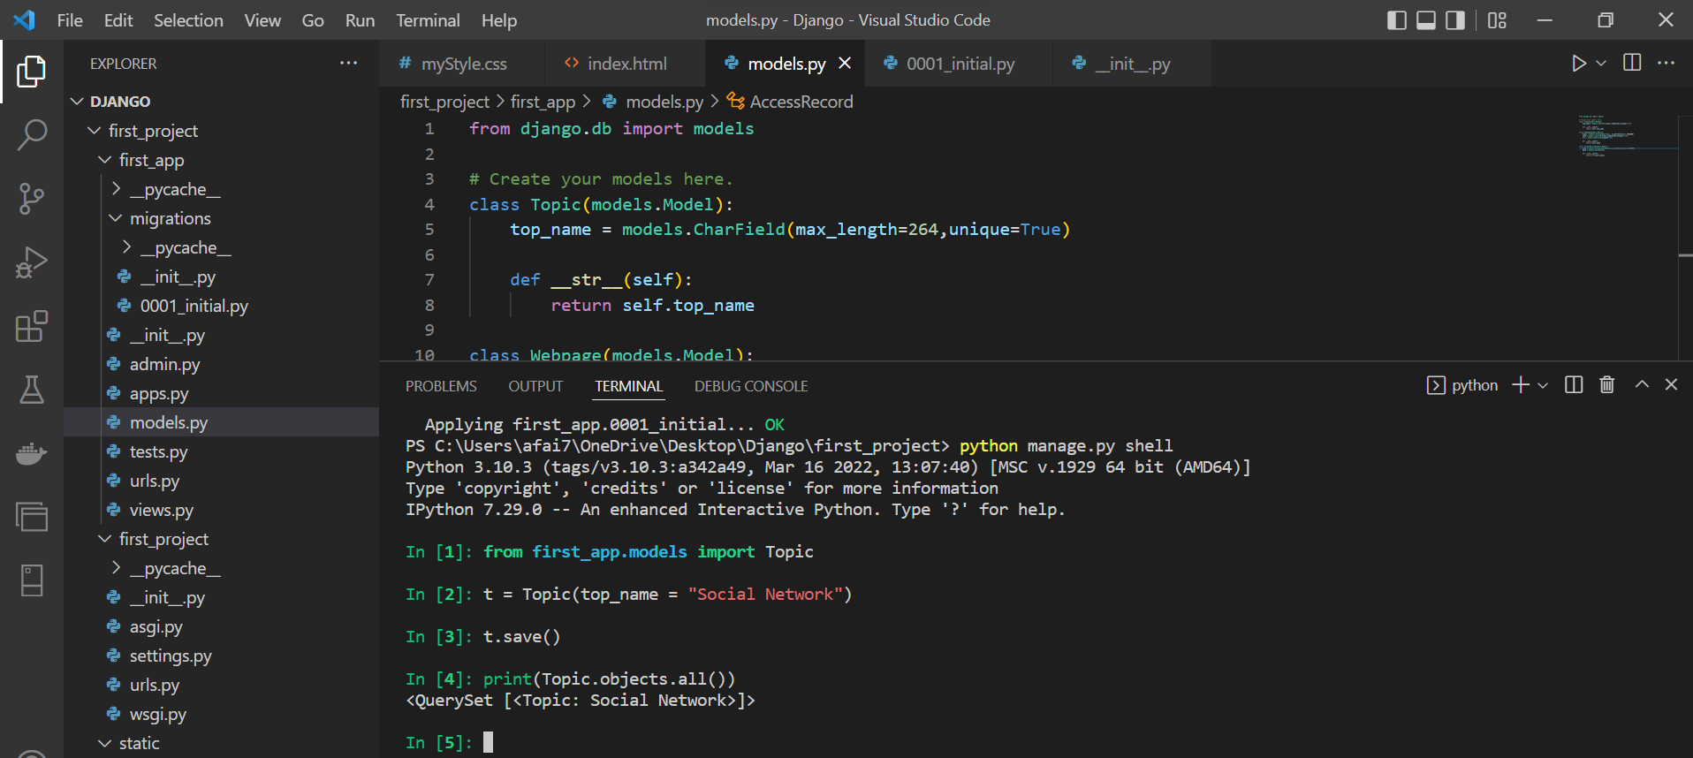
Insert data
19

Slide 20
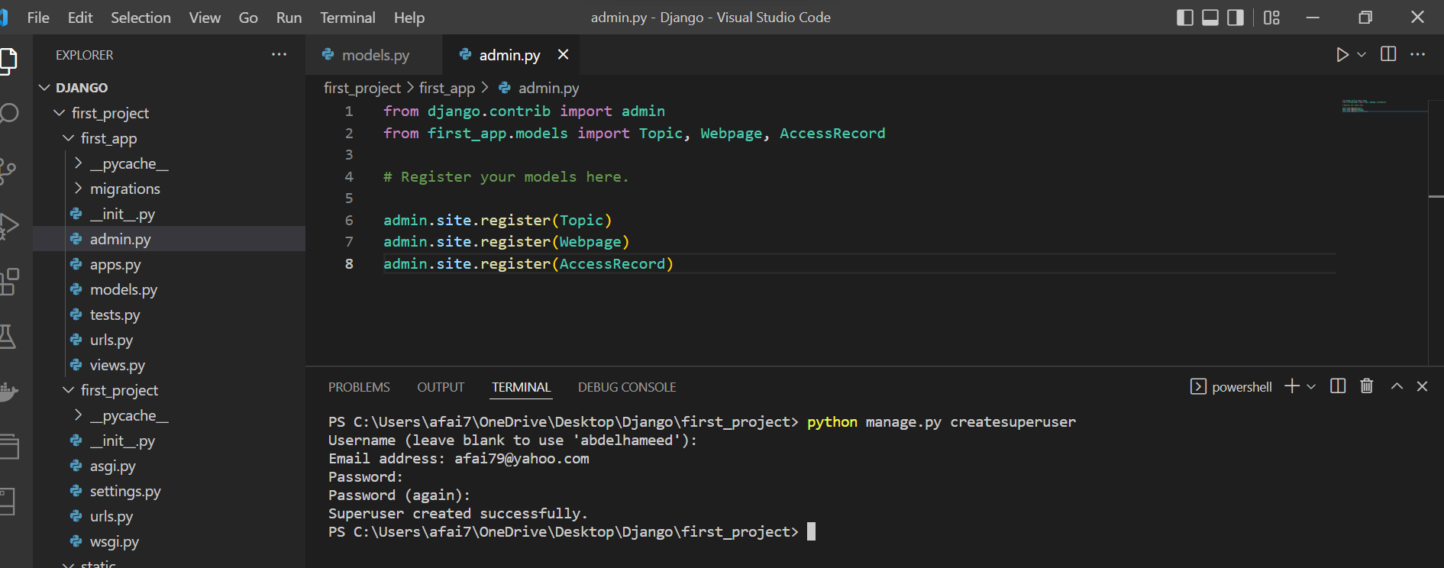
To use admin and createsuperuser
20

Slide 21
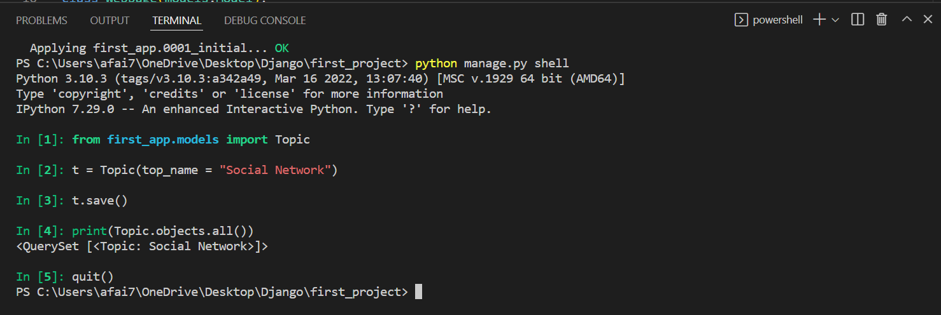
quit()
21

Slide 22
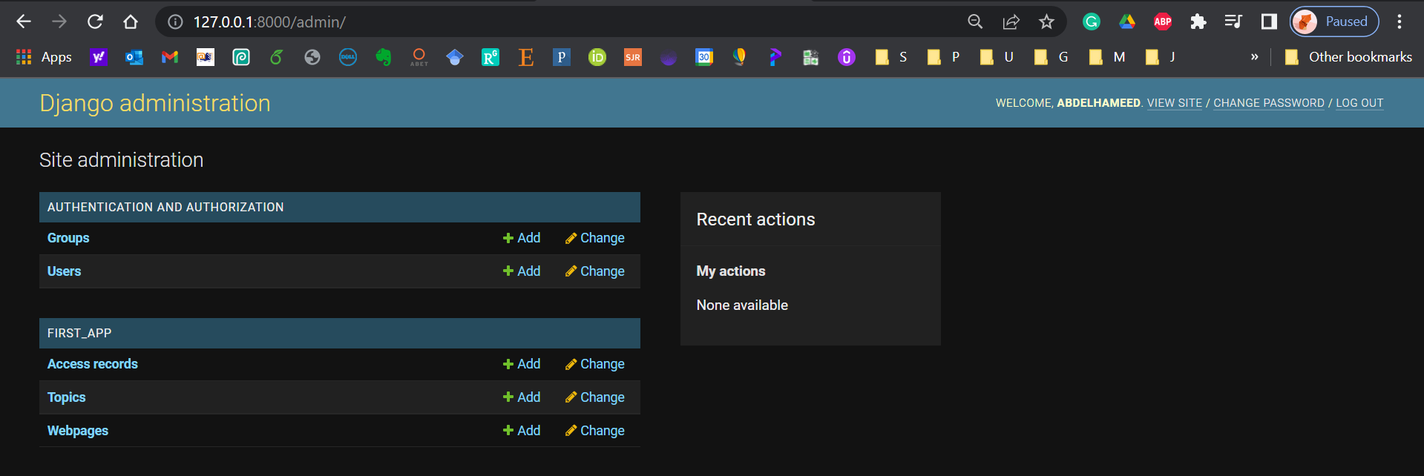
To use admin and createsuperuser
22

Slide 23

Learning Objectives - Confirm
You can download the code created in this Training from my GitHub account:
https://github.com/afai79/Django-Python
23

Slide 24
Django – Challenge 3
24

Slide 25
Challenge 3
Develop a Django web form that Creating Book store Database
25

Slide 26
Books App {
- List books with their information
- Search for a book
- Author Profile}
Books {Id, Title, Abstract, ISBN, Author, Shelf}
Db Entities {
Books (Id, Title, Abstract, ISBN, AuthorID, ShelfID)
Authors (Id, Name, Email)
Shelves (Id, Name)
}
26

Slide 27



Thanks
Dr. Abdelhameed Fawzy

